Slide 1
LESSON 6.3a
Introduction to Logarithms

Slide 2
Today you will:
Learn what logarithms and logarithm functions are and how to evaluate them
Learn about two special logarithms: common logs and natural logs
Practice using English to describe math processes and equations

Slide 3
Core Vocabulary:
Logarithm base $b$ of $y$, p. 310
Common logarithm, p. 311
Natural logarithm, p. 311
Previous:
Inverse functions

Slide 4
What is an Exponential Function?
Variable is in the exponent!
$$y=ab^{x}$$
Leading coefficient
Base
Not a variable, just a number

Slide 5

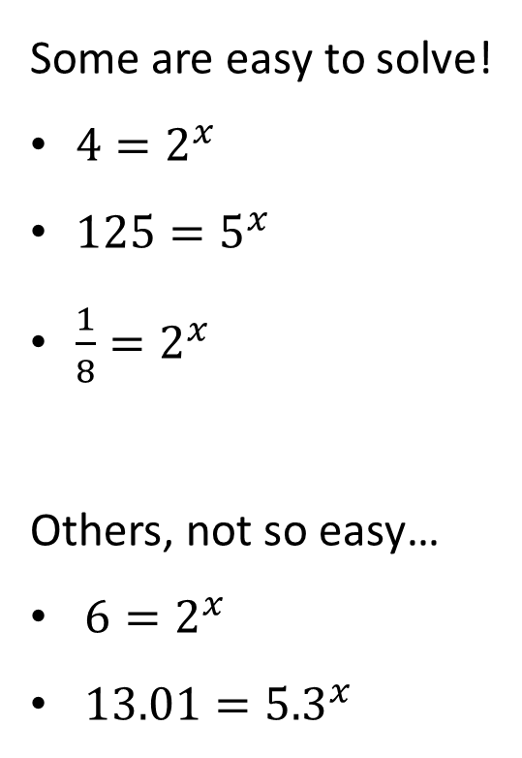
Some are easy to solve!
$4=2^{x}$
$125=5^{x}$
$\frac{1}{8}=2^{x}$
Others, not so easy…
$6=2^{x}$
$13.01={5.3}^{x}$
$$x=2$$
$$x=3$$
$$x=−3$$
How do we solve these things when they get weird?
Logarithms! ☺

Slide 6
Logarithm
Another way of writing $y=b^{x}$
$$\log_{b}{y}=x$$
Read it as “Log base $b$ of $y$ is $x$”
…as an exponential function it is $b$ to the $x$ is $y$

Slide 7
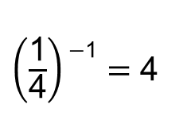
Rewrite each equation in exponential form.
a. log₂ 16 $=$ 4
b. log₄ 1 $=$ 0
c. log₁₂ 12 $=$ 1
d. log_{1/4} 4 $=$ $−$1
SOLUTION
Logarithmic Form
Exponential Form
a. log₂ 16 $=$ 4
2⁴ $=$16
b. log₄ 1 $=$ 0
4⁰ $=$ 1
c. log₁₂ 12 $=$ 1
12¹ $=$ 12
$\left(\frac{\text{1}}{\text{4}}\right)\text{−}\text{1}=$ 4
d. log_{1/4} 4 $=$ $−$1

Slide 8
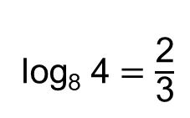
Rewrite each equation in logarithmic form.
a. 5² $=$ 25
b. 10$−$¹ $=$ 0.1
c. 8^{2/3} $=$ 4
d. 6$−$³ $=$ $\frac{\text{1}}{\text{216}}$
SOLUTION
Exponential Form
Logarithmic Form
a. 5² $=$ 25
log₅ 25 $=$ 2
b. 10$−$¹ $=$ 0.1
log₁₀ 0.1 $=$ $−$1
log₈ 4 $=$ $\frac{\text{2}}{\text{3}}$
c. 8^{2/3} $=$ 4
d. 6$−$³ $=$ $\frac{\text{1}}{\text{216}}$
log₆ $\frac{\text{1}}{\text{216}}$ $=$ $−$3

Slide 9

Some special logarithm values:
$\log_{b}{1}= ?$
$b^{?}=1$
$?=0$
$\log_{b}{b}= ?$
$b^{?}=b$
$?=1$
$$0$$
$$b^{0}=1$$
Rewrite as exponential
…anything raised to the zero power is 1
$$1$$
$$b^{1}=b$$
Rewrite as exponential
…anything raised to the 1st power is itself

Slide 10
Evaluate each logarithm. Some easier ones you can maybe do in your head…
a. log₄ 64
b. log₅ 0.2
c. log_{1/5} 125
d. log₃₆ 6
SOLUTION
To help you find the value of log_{b} y, ask yourself what power of b gives you y.
a. What power of 4 gives you 64?
4³ $=$ 64, so log₄ 64 $=$ 3.
b. What power of 5 gives you 0.2?
5$−$¹ $=$ 0.2, so log₅ 0.2 $=$ $−$1.
$\left(\frac{\text{1}}{\text{5}}\right)−$³ $=$ 125, so log_{1/5} 125 $=$ $−$3.
c. What power of $\frac{\text{1}}{\text{5}}$ gives you 125?
d. What power of 36 gives you 6?
36^{1/2} $=$ 6, so log₃₆ 6 $=$ $\frac{\text{1}}{\text{2}}$.

Slide 11
Now … what about solving something like $6=2^{x}$?
Gonna need our calculators for this one.
Look at your calculator, there are two buttons on it related to logarithms,
can you find them?
LOG
LN
For each of these, what is the 2nd function (in blue)?
LOG → ${10}^{x}$
LN → $e^{x}$
These are logarithms each with a specific base…
Not doing that in our heads!

Slide 12
Common Logarithm:
A logarithm with base 10
Denoted as $\log_{10}{}$… or as just $\log{}$
If you see the word “log” with no base identified, it is automatically base 10
Natural Logarithm:
A logarithm with base $e$
Denoted as $\ln{}$ … can be written as $\log_{e}{}$but you will rarely if ever see this
If you see the word “ln”, it is automatically base $e$

Slide 13
This means the only exponential functions our calculator can directly help us with are ones with base 10 or base $e$.
So how do you solve an exponential function that does not have a base of 10 or $e?$
We will learn how to do that in a few days! Be patient!
Right now we are going to focus on common logs (base 10) and natural logs (base $e$).

Slide 14
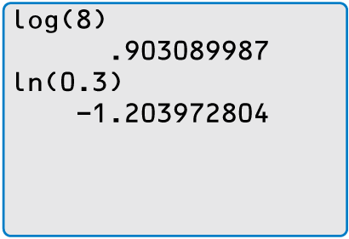
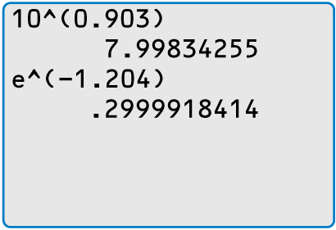
Evaluate (a) log 8 and (b) ln 0.3 using a calculator. Round your answer to
three decimal places.
SOLUTION
Check
Most calculators have keys for evaluating common
and natural logarithms.
a. log 8 $≈$ 0.903
b. ln 0.3 $≈$ $−$1.204
Check your answers by rewriting each logarithm
in exponential form and evaluating.

Slide 15
Homework
Pg 314, #1-34

